Slide 1





DISCOVERY AND RE-USE OF SCHOLARLY LITERATURE
IDENTIFYING INFORMATION SOURCES
Research4Life is a public-private partnership of five programmes:

Slide 2

Outline
Identifying relevant information
Level of information
Refining results
Primary, secondary, and tertiary sources
Academic versus popular information
Types of Information resources
Access tools
Evaluating information resources
Summary
This work is licensed under Creative Commons Attribution-ShareAlike 4.0 International (CC BY-SA 4.0)

Slide 3
Learning objectives
Identify relevant sources of information
Distinguish different types of information resources
Become familiar with criteria to evaluate information resources
Notes:
In this lesson, learners will learn how to identify relevant information sources, identify types of information sources and evaluate information sources
This will help to ensure that they identify their information needs, locate them efficiently, evaluate the information resources and use them to the fullest in order to enhance their research both as a user and researcher

Slide 4
Identifying relevant information
There are various tools & services that can be used by researchers for online research.
Information managers assist researchers in;
identifying different types of sources
evaluating the originality of the sources;
advising which tools and resources to use;
employing search techniques to retrieve the best search results
evaluating the information sources.
Notes:
In order to conduct an effective literature search, you need to be able to clearly know your information requirements, then translate them into an effective search syntax.
In this way, researchers can identify the information sources available in the academic world, and also be able to use the information tools to retrieve relevant content.

Slide 5
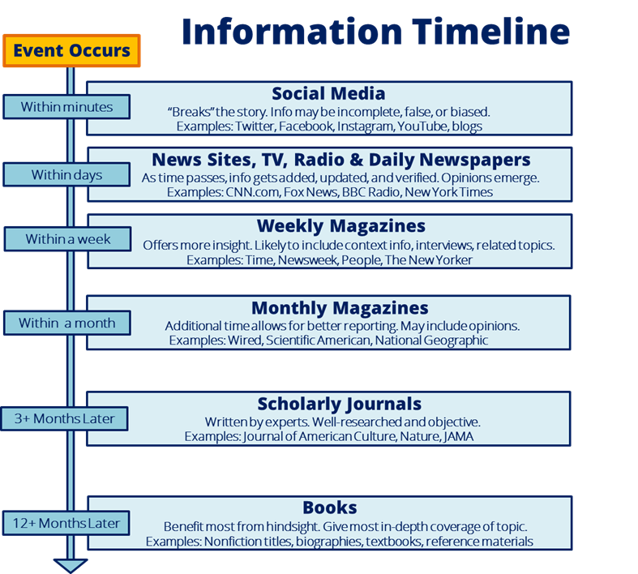
Information timeline
Information sources become available in the order in which an event occurs.
The latest information can be a deciding factor in identifying the best source.
The graphic shows an example of an event that occurs and the type of information sources that are then produced.
Source: University of Michigan. n.d. “Step 2: Identifying Information Sources: Library Skills.” Accessed April 3, 2020. https://umich.instructure.com/courses/83460/pages/step-2-identifying-information-sources.
Notes:
When deciding what types of sources would best meet your needs, it is helpful to understand the information timeline. When an event happens, information on that event gets filtered down through different sources. As it gets farther down the information timeline, the more that event is analyzed.
The initial information that is disseminated includes quick facts and interviews about the event that is published in the news and online. As time progresses, the information is studied in more depth and is then published in journals or books.
So if you have a new or recent topic, you are not likely going to find much in journals or books. Also, information that comes out initially may or may not be properly verified and might be biased based on who is reporting it. As information progresses down the timeline, it is looked at in more depth and is then published in scholarly journal articles and books. For this reason, most instructors prefer you to use scholarly journal articles and books as your sources.

Slide 6
Types of information sources
Primary sources | Secondary sources | Tertiary sources
First formal appearance of results Present the original idea New research or theories are first revealed Allow researchers to get as close as possible to original ideas, events, and first-hand research Examples: Interviews, analyzed field data, original experiments or research | Interpretations and evaluations of primary sources Analyze, review, or summarize information in primary sources & other secondary sources Rely on other secondary sources and standard disciplinary methods to reach results Examples: Review articles, journal articles, academic books, dissertations | Information based on both primary and secondary sources Provide data within a context which can help the researcher interpret the information Provide facts and brief descriptions of key information Present summaries and general information Examples: encyclopedias, textbooks, indexes, bibliographies

Slide 7
Advantages and Disadvantages
Type of source | Advantages | Disadvantages
Primary sources | Original data Unbiased information | Large volume of data Time consuming
Secondary sources | Rapid access to primary literature Generally high standard journals The ability to perform complex searches Routine updates on selected topics (alerts) | Time lag Command language varies Proficient search skills are needed Can be expensive
Tertiary sources | Easy access Easy to use Concise Relatively inexpensive | Time lag Outdated Incomplete information Incorrect interpretation

Slide 8
Information resources
Newspapers: are a collection of articles about current events usually published daily.
Magazines: are a collection of articles and images about different topics of popular interest and current events (e.g. ‘National Geographic’, ‘People’).
Trade journals: are a collection of news, trends and articles for a specific industry written by professionals, and experts in that field. (e.g. ‘APA Monitor’, ‘Advertising Age’).
Academic (peer reviewed) journal: is a collection of articles written by scholars and peer reviewed by experts in the field.
Book (monograph): can cover any topic, fact or fiction in a volume. For research purposes, it is better to use books which are subject specific.
Theses: A thesis or dissertation is a document containing the author's research and findings and is submitted by a student for an academic degree or professional qualification.
Conference Proceedings: are a collection of published papers presented at an academic conference.

Slide 9
Information resources cont.
Reference materials: refer to encyclopedias, dictionaries and thesauri. They are a collection of short factual entries written by different contributors.
Report (working, technical): is a separately published record of research findings, research in progress or other technical findings, usually classified with a report number and sometimes a grant number assigned by the funding agency.
Patent: is a government authority or license giving a right or title for a set period of time, and the sole right to make, use or sell an invention.
Web sites: are a set of related web pages typically served from a single web domain. All publicly accessible websites collectively constitute the World Wide Web.

Slide 10
What is an information access tool?
When starting a research project, it is important to know;
Where to find information,
What type of resources are offered in what kind of access service and platform.
These services and platforms are called access tools. They are utilized to locate different types of information resources.
Please note, not all access tools are free of charge!!!
Always check your library for subscribed collections and tools available in your institution.
Notes:
These access tools are online and, in many cases, available on mobile devices which you can use and search resources on the go, independently from time and place:

Slide 11
Types of access tools
1. Library catalogues & discovery tools – cover the library’s collection including books, journals and any other material, allows one to search across all the subscribed content by library.
2. Databases - provided by the publishers for a fee or free of charge. They can cover articles, book chapters, proceedings and reports. They are particularly useful in finding academic content on specific subjects.
3. Repositories - consist of academic institutions’ output including articles, proceedings, reports and research data e.g.
3. Indexes – these are bibliographic and citation indexes used for literature search as well as finding quality publications. They can be subject-specific or interdisciplinary, & sometimes include a full-text of the publications.
4. Search engines - they index any type of Internet source harvestable by the engines and provide information users with unlimited Internet sources. Google is the most used search engine in the world.

Slide 12
Evaluating information resources
Key areas to consider when evaluating information resources
In today’s internet environment, anyone can be an author. As a result, not all information is reliable or true !
Information resources should be evaluated accurately, particularly when online.
Users must be able to critically evaluate the appropriateness of all types of information sources prior to relying on the information.
Accuracy
Authority
Objectivity
Coverage
Currency

Slide 13
1. Authority
Who is the author?
Is the author affiliated to a reputable university or organization?
What is the author's educational background or experience?
What is their area of expertise?
Has the author published in academic or peer reviewed publications?
Does the author/Web Master provide contact information?
Notes:
What are his credentials
-Relevant university degree
-Institutional affiliation (where does he or she work?)
-Relevant field or employment experience
-Past writings
What is the author’s reputation among his/her peers?
-Cited in articles, books or bibliographies on the topic
-Mentioned in your textbook or by your professor
Memberships
Is the author associated with a reputable institution or organisation?
-Organizational mission
-Basic values or goals
-National or international

Slide 14
2. Accuracy
Is the information provided based on proven facts?
Is it published in an academic or peer-reviewed publication?
Can you find when it was last updated?
Is there an editor or someone who verifies/checks the information?
Is the page free of spelling mistakes or other obvious problems?

Slide 15
3. Objectivity
How objective is the information?
What do you know about who is publishing the information?
Is there a political, social or commercial agenda?
Does the information try to inform or persuade in an inappropriate way?
How balanced is the presentation in opposing perspectives?
What is the tone of language used (angry, sarcastic, emotive, objective)?
Notes:
Does the author state the goals for this publication?
- Inform, explain, educate
- Advocate
- Persuade or dissuade
- Sell a product or service
Does the author exhibit a particular bias?
- Commitment to a point of view
- Acknowledgement of bias
- Presentation of facts and arguments for both sides of a controversial issue
- Language free of emotion-arousing words and bias
Is the viewpoint of the author's affiliation reflected in the message or content?
- Organization's (e.g., government, university, business, association) point of view on the topic being discussed
- Organization's mission and activities
- Advertising is clearly labelled
- Benefits to organization
Does the information appear to be valid and well-researched?
- Reasonable assumptions and conclusions
- Arguments and conclusions supported by evidence
- Opposing points of view addressed
- Opinions not disguised as facts
- Authoritative sources cited

Slide 16
4. Coverage.
Does the information covered meet your information needs?
Is the coverage basic or comprehensive?
Is there an "About Us" link that explains subject coverage?
Is the information relevant to your topic?
Does this page have information that is not found elsewhere?
How in-depth is the material?
Notes:
Does the work update other sources?
Does it substantiate other materials you have read, or add new information?
Have you found enough information to support your arguments?

Slide 17
5. Currency
When was the information published?
When was the web site last updated?
Is timeliness important for your information needs?
Are the links up to date and do they point to existing pages?
Notes:
When was it published?
Is your topic one that requires current information?
Has this source been revised, updated, or expanded in a subsequent edition?

Slide 18
Summary
This lesson introduced types of information sources based on their originality, variety of information tools and resources, and methods to evaluate retrieved resources.

Slide 19
You are invited to;
Visit us at www.research4life.org
Contact us at r4l@research4life.org
Find out about other training materials [www.research4life.org/training]
Subscribe to Research4Life newsletter [www.research4life.org/newsletter]
Check out Research4Life videos [https://bit.ly/2w3CU5C]
Follow us on Twitter @r4lpartnership and Facebook @R4Lpartnership

Slide 20
For more information on Research4Life
www.research4life.org
r4l@research4life.org
Research4Life is a public-private partnership of five programmes:

